Slide 1
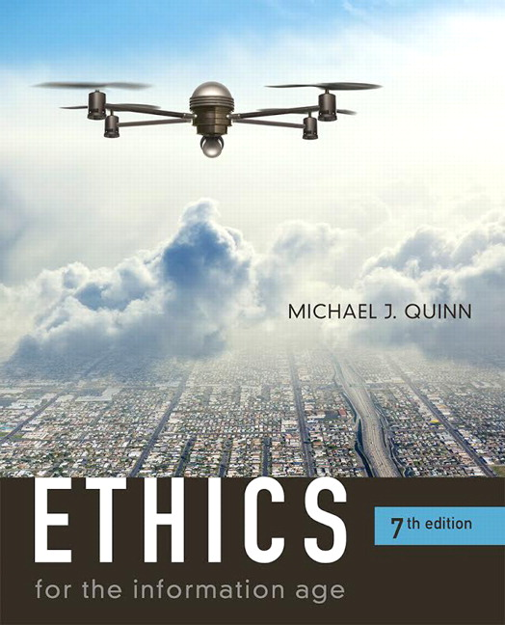
Chapter 2: Introduction to Ethics

Slide 2
Chapter Overview
Introduction
Nine ethical theories
First four “unworkable”
Last five “workable”
Comparing workable ethical theories
Morality of breaking the law

Slide 3
2.1 Introduction

Slide 4
We Live in Communities (London, England at night from space)
Courtesy of NASA

Slide 5
The Ethical Point of View
Most everyone shares “core values”, desiring:
Life
Happiness
Ability to accomplish goals
Two ways to view world
Selfish point of view: consider only your own self and your core values
Ethical point of view: respect other people and their core values

Slide 6
Defining Terms
Society
Association of people organized under a system of rules
Rules: advance the good of members over time
Morality
A society’s rules of conduct
What people ought / ought not to do in various situations
Ethics
Rational examination of morality
Evaluation of people’s behavior

Slide 7
Analogy: Difference between Morality and Ethics

Slide 8
Why Study Ethics?
Ethics: a way to decide the best thing to do
New problems accompany new technologies
“Common wisdom” may not exist for novel situations brought about by new technologies

Slide 9
More on Ethics
Ethics: rational, systematic analysis
“Doing ethics” means explaining conclusions
Best explanations based on facts, shared values, logic
Ethics focuses on people’s voluntary, moral choices
Workable ethical theory: produces explanations that might be persuasive to a skeptical, yet open-minded audience

Slide 10
A Good Ethical Theory Supports Persuasive, Logical Arguments

Slide 11
Scenario 1 (p. 52)
Did Alexis do anything wrong?
Who benefited from Alexis’s course of action?
Who was hurt by Alexis’s course of action?
Did Alexis have an unfair advantage over her high school classmates?
Would any of your answers change if it turns out Alexis did not win a college scholarship after all?
Are there better ways Alexis could have achieved her objective?
What additional information, if any, would help you answer the previous questions?

Slide 12
Scenario 4 (p. 54)
Should you recommend release of the product next week?
Who will benefit if the company follows your recommendation?
Who will be harmed if the company follows your recommendation?
Do you have an obligation to any group of people that may be affected by your decision?
What additional information, if any, would help you answer the previous questions?

Slide 13
2.2 Subjective Relativism

Slide 14
Relativism and Subjective Relativism
Relativism
No universal standards of right and wrong
One person can say “X is right,” another can say “X is wrong,” and both can be correct
Subjective relativism
Each person decides right and wrong for himself or herself
“What’s right for you may not be right for me”

Slide 15
Case for Subjective Relativism
Well-meaning and intelligent people disagree on moral issues
Ethical debates are disagreeable and pointless

Slide 16
Case Against Subjective Relativism
Blurs line between doing what you think is right and doing what you want to do
Makes no moral distinction between the actions of different people
SR and tolerance are two different things
Decisions may not be based on reason
XS – No one allows others to harm their interests on the basis of relativism.
Conclusion: Not a workable ethical theory

Slide 17
2.3 Cultural Relativism

Slide 18
Cultural Relativism in a Nutshell
What is “right” and “wrong” depends upon a society’s actual moral guidelines
These guidelines vary from place to place and from time to time
A particular action may be right in one society at one time and wrong in another society or at another time

Slide 19
Case for Cultural Relativism
Different social contexts demand different moral guidelines
It is arrogant for one society to judge another

Slide 20
Case Against Cultural Relativism
Because two societies do have different moral views doesn’t mean they ought to have different views
It doesn’t explain how moral guidelines are determined
What if there are no cultural norms?
It doesn’t account for evolution of moral guidelines.
It provides no way out for cultures in conflict
Existence of many acceptable practices does not imply all practices are acceptable (many/any fallacy)
Societies do, in fact, share certain core values
Only indirectly based on reason
Conclusion: Not a workable ethical theory

Slide 21
2.4 Divine Command Theory

Slide 22
Overview of Divine Command Theory
Good actions: those aligned with God’s will
Bad actions: those contrary to God’s will
Holy books reveal God’s will
We should use holy books as moral decision-making guides

Slide 23
Divine Command Theory in Action

Slide 24
Case for Divine Command Theory
We owe obedience to our Creator
God is all-good and all-knowing
God is the ultimate authority

Slide 25
Case Against Divine Command Theory
Different holy books disagree on certain teachings
Society is multicultural, secular
Some modern moral problems not directly addressed in scripture
“The good” ≠ “God” (equivalence fallacy)
Based on obedience, not reason
Conclusion: Not a workable ethical theory for our purposes

Slide 26
2.5 Ethical Egoism

Slide 27
Definition of Ethical Egoism
Each person should focus exclusively on his or her self-interest
Morally right action: that action that provides self with maximum long-term benefit
Ayn Rand, author of The Fountainhead and Atlas Shrugged, espoused a theory akin to ethical egoism

Slide 28
Case for Ethical Egoism
It is practical since we are already inclined to do what’s best for ourselves
It is better to let other people take care of themselves
The community can benefit when individuals put their well-being first
XS – Mandeville, The Fable of the Bees or ‘Private Vices, Public Benefits’
Other moral principles are rooted in the principle of self-interest

Slide 29
Case Against Ethical Egoism
An easy moral philosophy may not be the best moral philosophy
We know a lot about what is good for someone else
Self-interest can lead to blatantly immoral behavior
Other moral principles are superior to principle of self-interest
People who take the good of others into account lead happier lives
By definition, does not respect the ethical point of view
Conclusion: Not a workable ethical theory

Slide 30
Quiz 1 Review (10 MC questions)
Questions are drawn from the first half of chapter 2 (slides up until here).
Question terms:
The ‘ethical point of view’
Society
Morality
Ethics
Relativism/Relativist
Ethical Objectivism
Divine Command Theory x2
Ethical Egoism x2

Slide 31
Quiz 1 Review
Sample (hard) Question:
According to James Moor, taking “the ethical point of view” means
abiding by your religious beliefs.
deciding that other people and their core values are worthy of your respect.
choosing to sacrifice your own good for the good of someone else.
putting self-interest above the interests of everyone else.
refusing to accept help from other people.

Slide 32
Scenario 2 (p. 53)
Did the antispam organization do anything wrong?
Did the ISPs that refused to accept email from the blacklisted ISPs do anything wrong?
Who benefited from the organization’s action?
Who was hurt by the organization’s action?
Could the organization have achieved its goals through a better course of action?
What additional information, if any, would help you answer the previous questions?

Slide 33
Scenario 3 (p. 54)
Did the East Dakota State Police do anything wrong?
Who benefited from the actions of the EDSP?
Who was harmed by the actions of the EDSP?
What other courses of action could the EDSP have taken to achieve its objectives?
What additional information, if any, would help you answer the previous questions?

Slide 34
2.6 Kantianism

Slide 35
Critical Importance of Good Will
Good will: the desire to do the right thing
Immanuel Kant: Only thing in the world that is good without qualification is a good will
XS – what is an example of happiness that is at odds with a good will?
Reason should cultivate desire to do right thing

Slide 36
Categorical Imperative (1st Formulation)
Act only from moral rules that you can at the
same time will to be universal moral laws.

Slide 37
Illustration of 1st Formulation
Question: Can a person in dire straits make a promise with the intention of breaking it later?
Proposed rule: “I may make promises with the intention of later breaking them.”
The person in trouble wants his promise to be believed so he can get what he needs.
Universalize rule: Everyone may make & break promises
Everyone breaking promises would make promises unbelievable, contradicting desire to have promise believed
The rule is flawed. The answer to the question is “No.”

Slide 38
Another Way to Reason It Out
Question: Can I make a promise with the intention of breaking it later?
I want my false promise to be believed.
In order for my false promised to be believable, I want everyone except myself to be truthful all the time.
In other words, I want to privilege my needs and desires over those of everyone else.
Contradiction between what I want to do and what I want others to do.
Therefore, what I am considering doing is wrong.

Slide 39
A Quick Check
When evaluating a proposed action, reverse roles
What would you think if that person did the same thing to you?
Negative reaction → evidence that your will to do that action violates the Categorical Imperative

Slide 40
Categorical Imperative (2nd Formulation)
Act so that you treat both yourself
and other people as ends in themselves
and never only as a means to an end.
This is usually an easier formulation to work
with than the first formulation of the
Categorical Imperative.

Slide 41
Kant: Wrong to Use Another Person Solely as a Means to an End

Slide 42
Plagiarism Scenario
Carla
Single mother
Works full time
Takes two evening courses/semester
History class
Requires more work than normal
Carla earning an “A” on all work so far
Carla doesn’t have time to write final report
Carla purchases report; submits it as her own work

